Slide 1


Birthdays in March
^{1st – Greg Shosey (Jackson)}
^{2nd – Scott Campbell (Jackson)}
^{4th – Tim Tarchinski (Jackson)}
5th – Maurice Burnett (Venture)
^{6th – Mohamed Hanek (Jackson)}
10th – Shontella Brown (Venture)
10th – Stephen Stranahan (Jackson)
^{14th – Luke Pilon (Venture)}
^{15th – Mil Ovan (Illinois)}
15th – Todd Trancygier (Jackson)
^{16th – Zach Smith (Jackson)}
^{18th – Jesus Yepez (Jackson)}
^{30th – Taylor Xu (Venture)}
31st – Nicole Bennett (Venture)
^{31st – Joseph Genise (Jackson)}

Slide 2

Anniversaries in March
9 Years
1st – Mil Ovan (Illinois)
6 Years
14th – Hong Wang (Venture)
3 Years
25th – Kevin Schelkun (Venture)
26th – Nelson Chacon-Poveda (Jackson)
2 Years
9th – Bryan Steinhoff (Venture)
1 Year
1st – Brian Delling (Jackson)
8th – Philipp Tapia (Remote)
15th – Martin Bridge (Jackson)
16th – Katie Hessling (Jackson)
22nd – Ryan Perry (Jackson)
22nd – Kevin Wilson (Jackson)
23rd – Amer Bishtawi (Venture)
29th – Jenn Silver (Jackson)

Slide 3
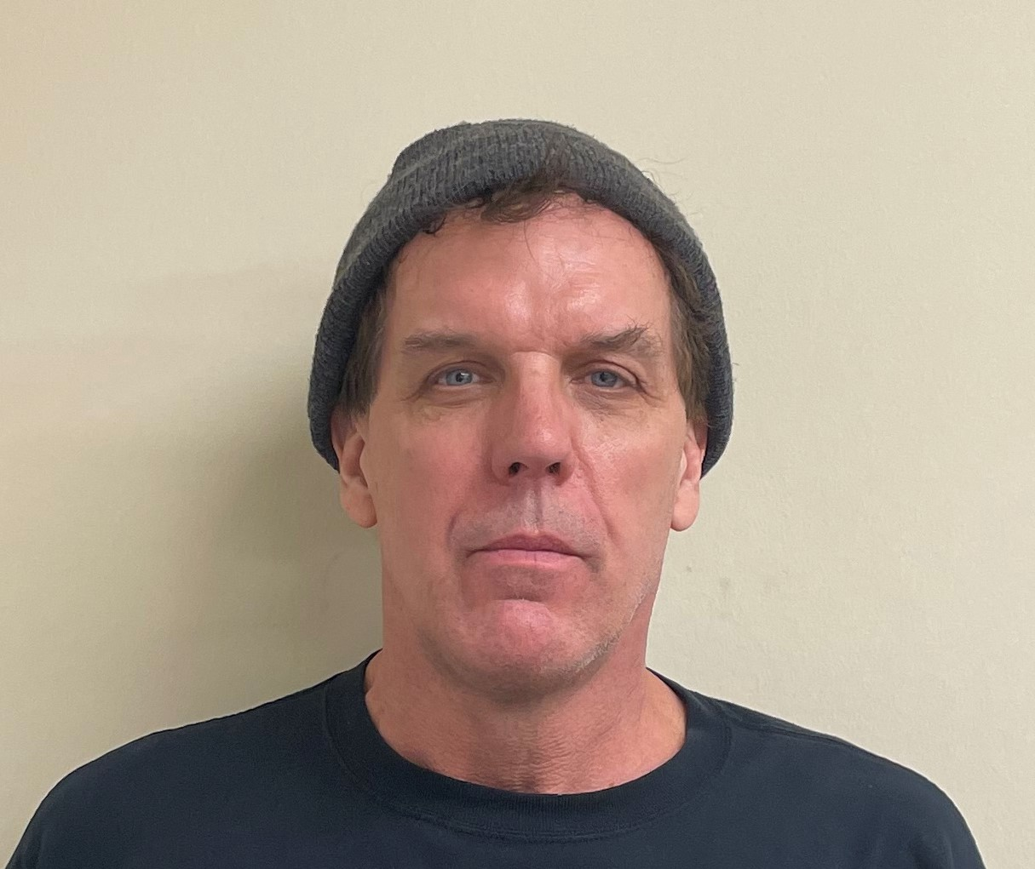
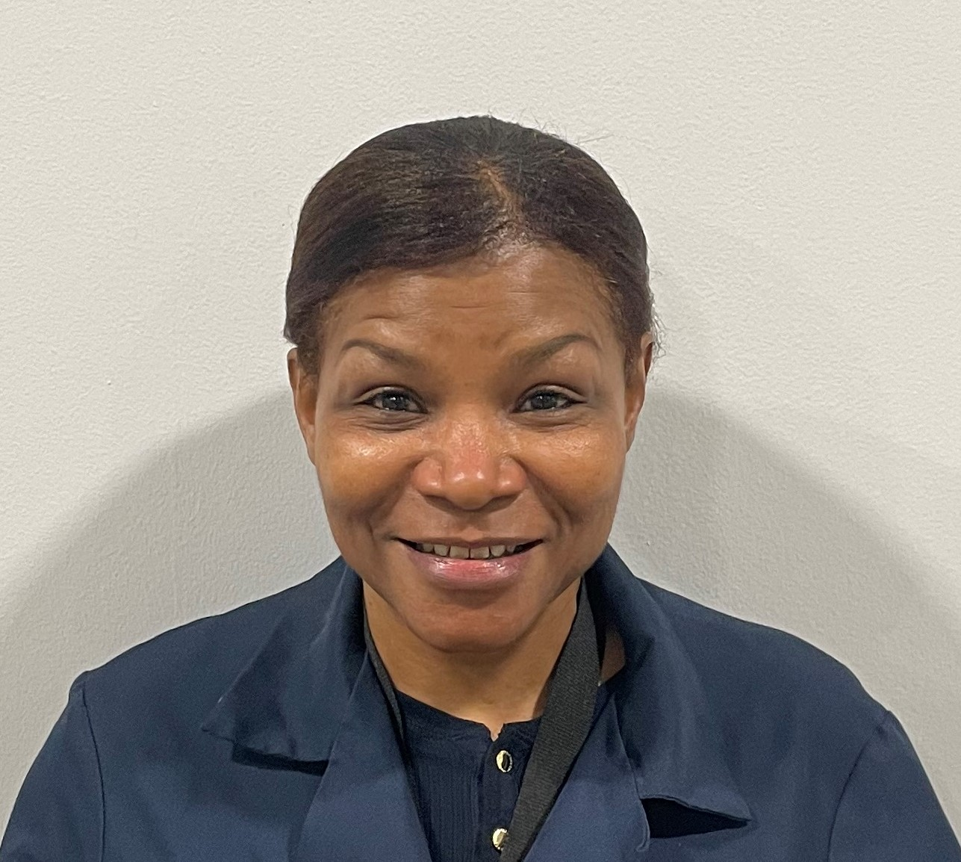
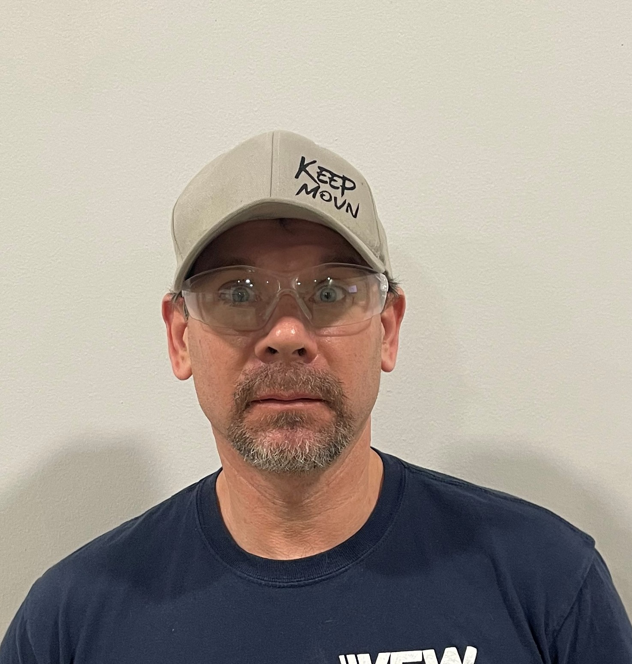

Recent New Hires
Don Jones
Jackson Production
Bonita Mays
Jackson Technician
Jeremy Schultz
Jackson Production

Slide 4
Current Open Positions
Salary
Senior Staff Accountant (Venture)
Materials Analyst (Jackson)
Senior Manufacturing Engineer (Jackson)
Applications Engineer (Jackson)
Research Engineer (Venture)
Senior Research Scientist (Venture)
Cell Test Engineer (Venture)
Hourly
Cell Formation Operator (Venture)
Manufacturing Engineering Tech (Venture)
Cell Product Development Intern (Venture)
Manufacturing Engineering Intern (Venture)
Systems Engineer Intern (Jackson)
Government Property Specialist (Venture)

